Slide 1
Arvind Krishna
Brief Portfolio
May 2020

Slide 2







Education and Career Trajectory
Education Indian Institute of Technology, Madras
The Ohio State University
Career Battelle Fracture Mechanics for Nuclear Piping
GM Delco Electronics Electronics Packaging
Delphi Automotive Systems Electronics Products
Enphase Energy Solar Microinverters
Oerlikon Thermal Spray Equipment
Graham Packaging Rigid Plastic Containers
Trajectory
Technical Analysis
Product Engineering
Product Development
Engineering Leadership

Slide 3
Industries and Products – Electronics Packaging and Automotive Electronics
Thin Film Delamination
Finite Element Analysis
Thermal Cycling & Moisture Susceptibility
Chip and Package Level Reliabil
Powertrain Modules (Engine Control)
Technology Development
(Flip Chips, Rubber Pedestals)
Design Tools
Design Guidelines
DFV (Design for Vibration)
Design for Reliability
Active Safety & Audio Systems (Radios, Telematics)
Wirebonds
Glass-Filled Plastics
Design for Manufacturability
Design for Thermal Cycling
System Level Bracket Design for Vibration
Power Electronics
Inverters and Battery Storage
Design for Cost
Liquid Cooling
Thermal Interface Materials
Isolation Mounts
Rapid Product Development
Design for Reliability

Slide 4
Industries and Products – Industrial Equipment
Thermal Spray Equipment
Controllers
Plasma and HVOF Torches
Powder Feeders
Product Development
Design Thinking for Branded Product Offerings
Innovation
Suspension Feeder
Spray-in-a-Booth
Modular Controllers
Global Software Partnerships
R&D Management
10M$ Budget – US and Swiss Resource Management
Technology Roadmaps
Vitality Index for Revenue Boost with New Products
Balancing NPD with Maintenance
Technology Incorporation
Additive Manufacturing for Cooling Channels
Machine Learning for Predictive Maintenance of Controller

Slide 5
Portfolio of Targeted Contributions

Slide 6
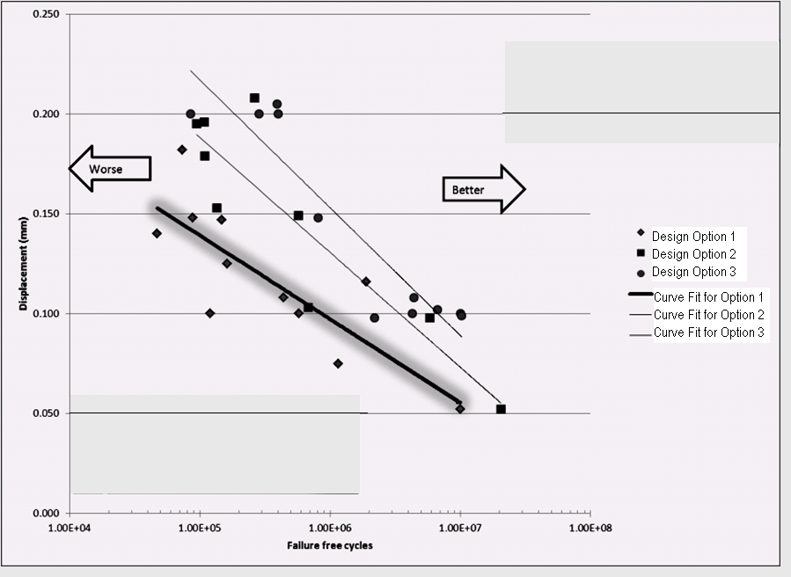
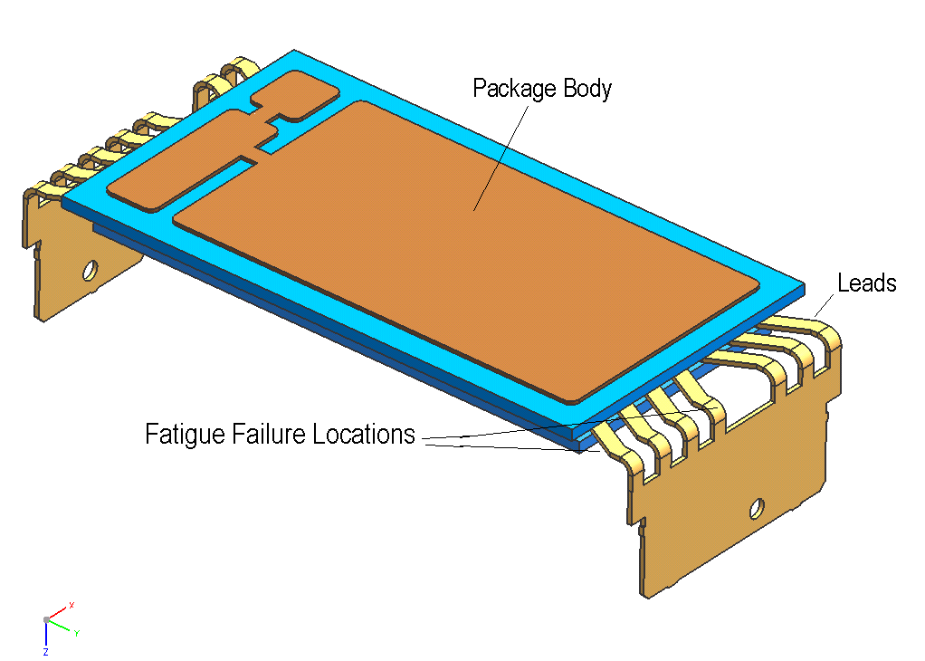
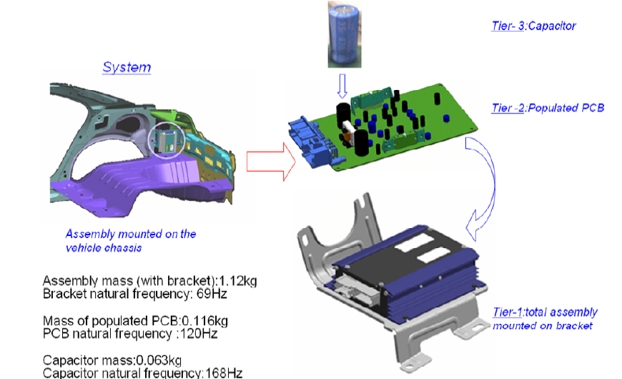
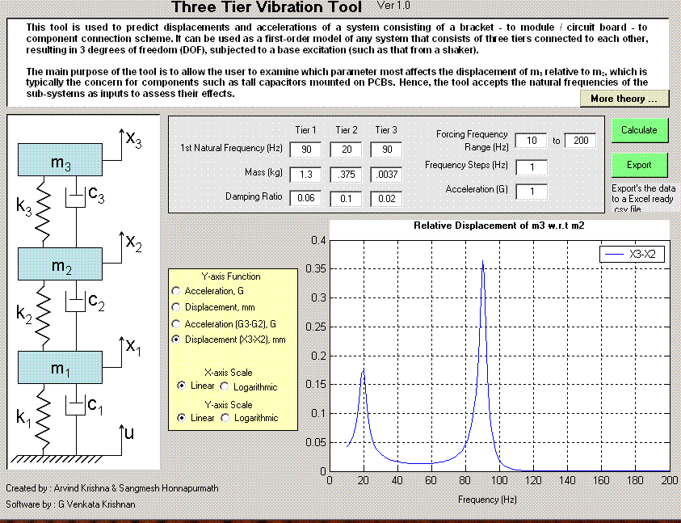
Design for Reliability (Vibration)
Component
Level
D
N
System Level

Slide 7
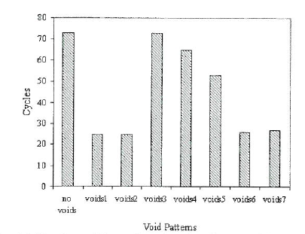
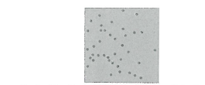
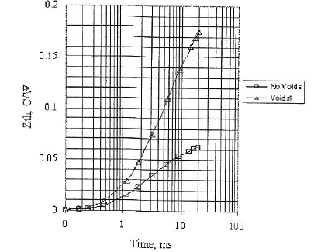

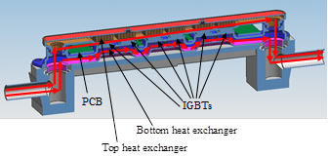
Design for Reliability (Thermal)
Component
Level
Solder Voids under a Critical IGBT
System Level
Channels under IGBT of Power Inverter to mitigate Thermal Interface Material Pumpout with Temp Cycling

Slide 8
Design for Cost
Present Inverter (Die Cast)
Die Cast Base $2.8
Die Cast Top $1.8
Plastic Case + Metal Spreaders
Plastic Base $1.3
Plastic Top $1.1
Smaller PCBA+Die Cast
Die Cast Base $1.4
Die Cast Top $1.2
Potting $5.5
Screws $0.40
Lightpipe $0.30
Connector Plate $6.2
Total ME BOM $ 17
Potting $4.4
Metal Spreader1 $0.8
Metail Spreader2 $0.8
Screws 0
Mounting Plate $1.1
Lightpipe $0.3
Connector $6.2
Total ME BOM $16
Potting $3.2
Screws $0.4
Lightpipe $0.3
Connector $6.2
Total ME BOM $12.7
TEAM RECOMMENDATION

Slide 9
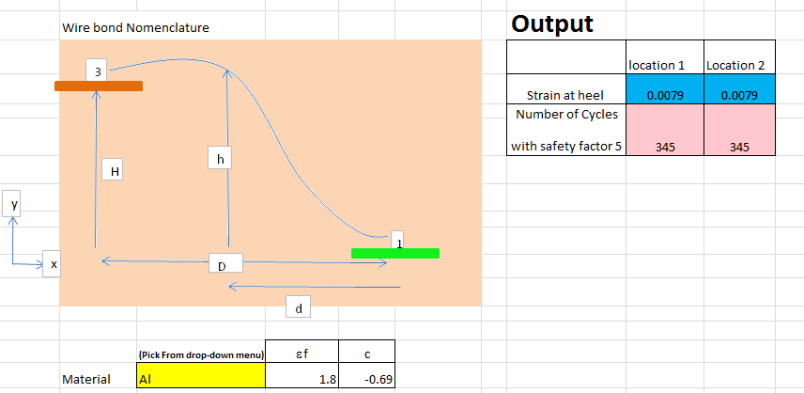
Design for Manufacturability (some examples)
Inverter
  Existing Scheme: Potting horizontal fill with “duckbill and stovepipe” features to fill and vent
  Implemented New Scheme: Potting vertical fill through Connector Plate eliminates duckbill and stovepipe, increases throughput and improves reliability (no stickers needed to seal vent)
Conformal Coating of a PCB Spacings between tall components on a PCBA must allow nozzle to spray
            Dip vs Spray processes (ease of use, throughput, capital cost) favor Spray Process for High Volume applications
Solder Voids for Joint Reliability Guideline to GM that 50% ligament size at end of Thermal Cycling is acceptable
This allows solder reflow process inspection to not discard parts with observed voids
Wirebond Geometry Resolve compromise between CTE mismatch based system movement at the bond bases and Vibration Performance if bond is made more flexible
Choose optimum bond loop configuration
Implemented Solution
Loop height and bend radii optimized with existing wirebond equipment travel path
Stay with Aluminum wirebond (not Copper) for continuity with existing processes

Slide 10
An Example of Technological Novelty
Resonant Structure and
Vibrometer-Based Fatigue
Testing for Leaded Electronic Packages
Pertinent and Targeted to Liquid Cooling Battery and Power Inverter Applications

Slide 11
Motivation for Vibrometer to Measure Movement
To capture full vibration response of tall low-mass components without having to rely on accelerometers
To create vibration specifications (sine response, random vibration, shock) for leaded capacitors in specific
Extend to leaded packages mounted on PCBs for vibration fatigue data
Laser Vibrometer
Laser Vibrometer
Tall Capacitor
PCB
Lead
Test set-up to measure lateral movement of a vibrating tall component on a PCB

Slide 12
Motivation for Leaded SMT Packages
Use an optical line-of-sight method (laser vibrometer) to directly measure movement on top of package.
Run quick tests to assess fatigue life as a function of imposed displacement.
Use the results to provide PASS/FAIL criteria for acceptable PCB movement below such packages for life.
For liquid-cooling applications, movement may be imposed on package body directly.

Slide 13
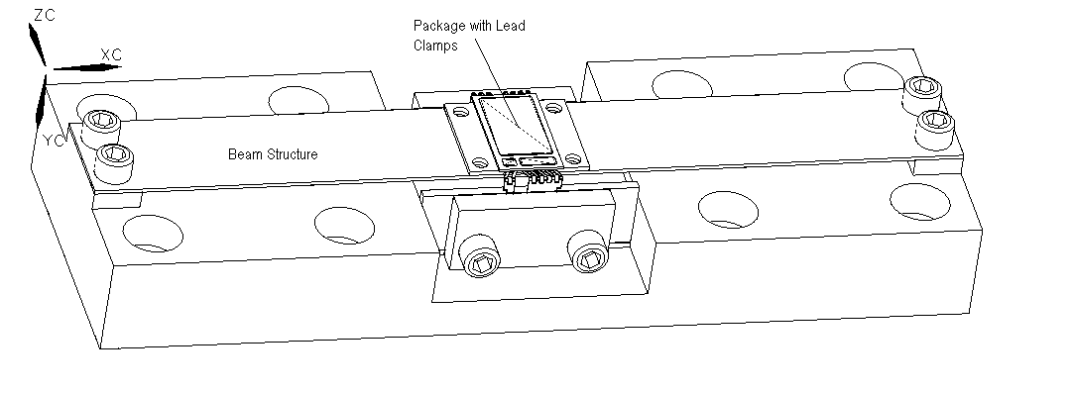
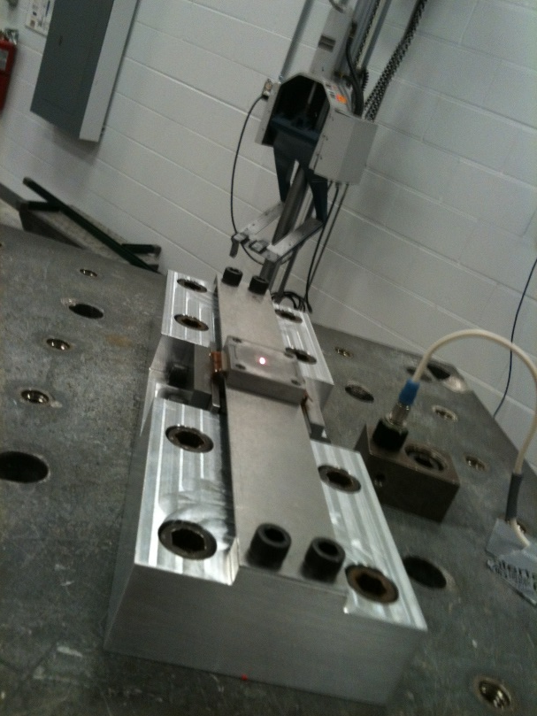
Description of Technique
Resonant Beam Structure
Central clamp restricts leads, so the laser point captures relative motion of package body to leads.

Slide 14
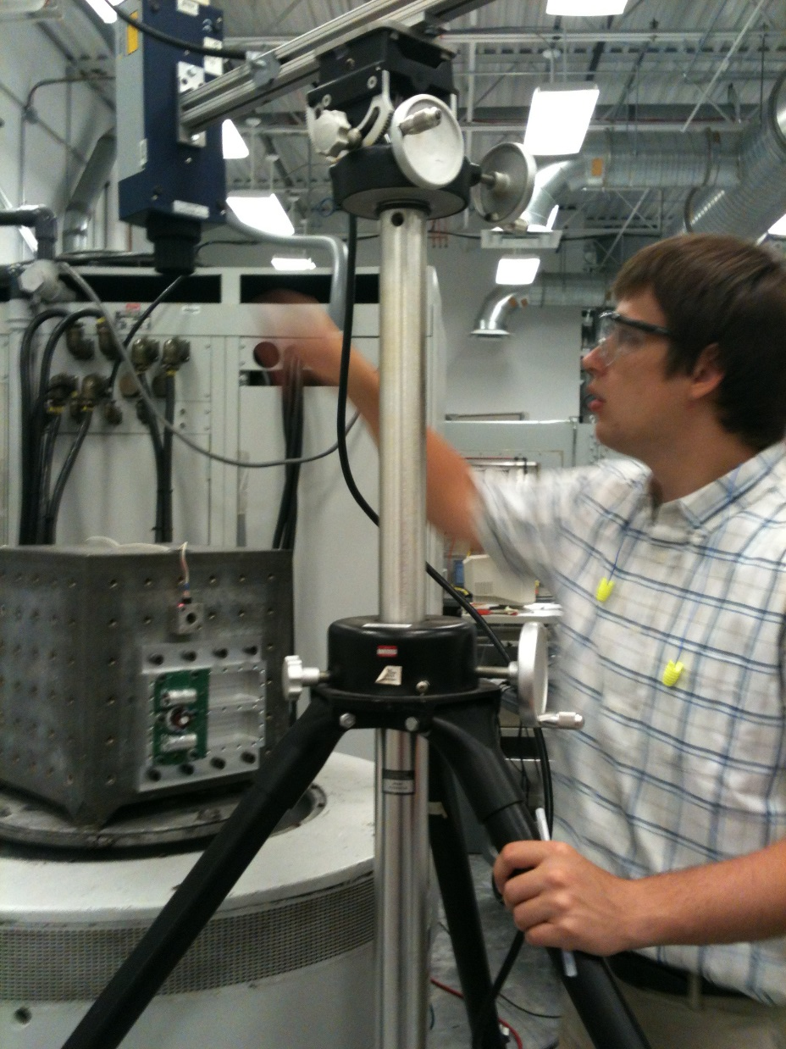
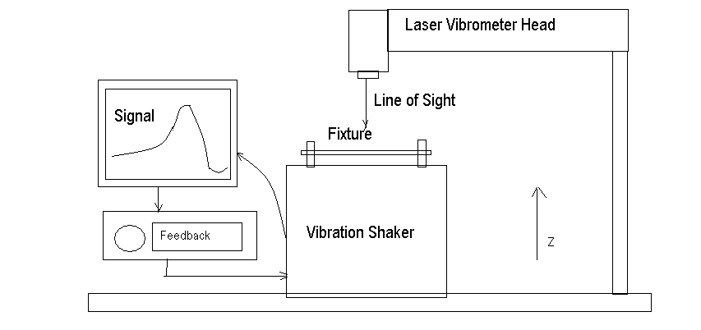
Experimental Setup

Slide 15
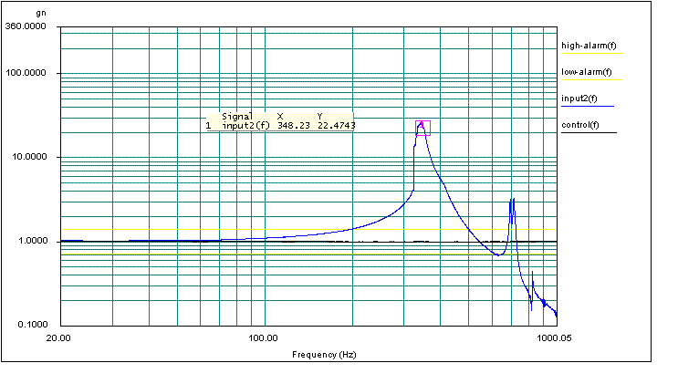
Dwell at Resonance to Amplify Imposed Displacement
Seek the resonant point of the beam fixture to maximize amplification, then dwell for the desired duration (number of cycles of fatigue).
Generate over 1 million fatigue cycles in less than an hour

Slide 16
Results for Leaded Package
These results were used to drive the max. acceptable displacement magnitude for different applications.
Design modifications (Options 1-3) refer to leadframe and lead geometries
Ex: 0.15 mm for 1 million cycles at 350 Hz is an acceptable imposed movement
D
N
D-N curve instead of an S-N curve

Slide 17
References
1. Li, R., “A Methodology for Fatigue Prediction of Electronic Components under Random Vibration Load,” ASME Journal of Electronic Packaging, Vol. 123, Dec. 2001, p. 394 – 400
2. Irvine, T., “Extending Steinberg’s Fatigue Analysis of Electronics Equipment Methodology to a Full Relative Displacement vs. Cycles Curve,” VibrationData.com, Feb. 2013
3. Steinberg, D., “Vibration Analysis for Electronic Equipment,” 2nd Edition, Wiley InterScience, 1988
ASME IMECE Paper
Polytec Laser Vibrometers

Slide 18
Additional Areas to Showcase
Executive Leadership
  Product Development of a Low Cost Inverter with new technologies (potting, plastic enclosure)
  Launch of 4 Industrial Equipment Thermal Spray products, with electro-mechanical system complexity
  Weight Optimization for Rigid Plastic Containers using simulation (blow molding, performance modeling)
Technical Complexity
  Double-Decker Automotive Battery Pack
    Selection of Rubber Mounts to handle low temperature performance
    Mitigation of Thermal Pad movement in vibration by breaking pad up into 2 or more pieces
  Selection of Amodel PPA as the Plastic of Choice for all Powertrain Controllers for Delphi
    Minimization of movement of connector pins due to Temperature Cycling by a) selection of low CTE material and b) optimizing injection gate location to reduce CTE induced solder fatigue
  Shell Buckling for Rigid Plastic Containers
    Viscoelastic and Viscoplastic Deformation causing dents with time and temperature

Slide 19
Designing with Suppliers and Partners
Some Examples
Rockwell Automation Digital Enterprise Transformation and Machine Learning incorporation
Siemens PLC industrial controls and automation, Digital Enterprise
CCAM Acoustics Monitoring in Thermal Spray Equipment
Hofstra Machine Learning, Vibration and Controls Research
Flextronics Battery Enclosure Design, Development and Manufacturing in Guadalajara
Dow Corning Silicone Potting Formulation, Properties Characterization, Flow Optimization
Foxconn Die Cast and Plastics DFM
Epcos E-Caps for Vibration Performance
Purdue University Thermal Interface Material (TIM) research

